Slide 1


POKEMON DATASET ANALYSIS TO OBTAIN STATISTICAL INFORMATION ON POKEMON CHARACTERS
Farrel Paksi Aditya
DATA SCIENCE DIGITAL SKILL FAIR 29.0 BY:

Slide 2

INTRODUCTION
Pokémon, short for "Pocket Monsters," is a media franchise created by Satoshi Tajiri and Ken Sugimori, and is managed by The Pokémon Company, a collaboration between Nintendo, Game Freak, and Creatures. It began with video games developed by Game Freak and published by Nintendo for the Game Boy in 1996. The franchise has since expanded to include an animated TV series, movies, trading card games, merchandise, and much more, capturing the hearts of millions around the globe. The core concept revolves around capturing and training creatures called Pokémon to battle each other for sport.
Pokémon, a globally recognized franchise, offers a rich dataset that is perfect for showcasing data science skills. Analyzing Pokémon data not only provides a fun and engaging way to apply data science techniques but also offers valuable insights into one of the most popular and enduring media franchises.
Let's dive in and discover the fascinating world of Pokémon through the lens of data science!

Slide 3
KEY OBJECTIVE
Understand Pokémon Attributes: Analyze key attributes such as Types, HP, Attack, Defense, Special Attack, Special Defense, and Speed.
Legendary vs. Non-Legendary: Investigate the differences and trends between Legendary and Non-Legendary Pokémon.
Type Distribution: Explore the distribution of Pokémon types and how they have evolved over different generations.
Generation Analysis: Examine how Pokémon stats have changed across generations and identify any significant trends.

Slide 4



TOOLS AND TECHNIQUES
TOOLS :
Google Colab for Code Editor
Microsoft Excell for Dataset
Python for Programming Language

Slide 5
TOOLS AND TECHNIQUES
TECHNIQUES:
Data Cleaning: Handling missing values and ensuring data quality.
Exploratory Data Analysis (EDA): Using visualization tools like Seaborn and Matplotlib to reveal patterns and insights.
Statistical Analysis: Applying statistical methods to compare and contrast different groups of Pokémon.
Visualization: Creating informative and visually appealing charts to present findings clearly.

Slide 6
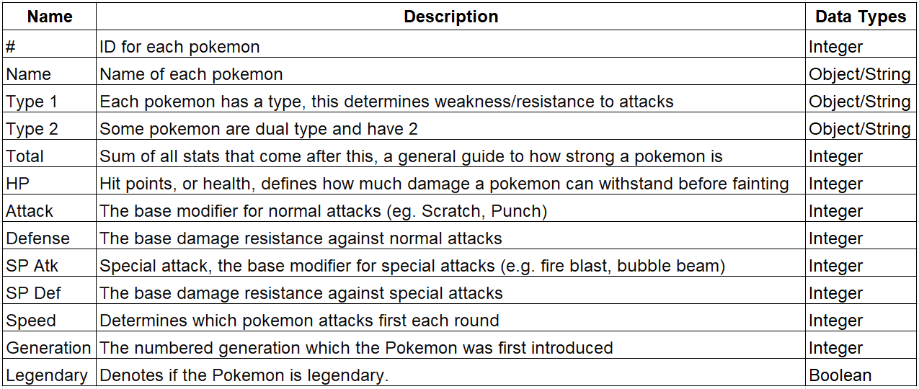
ABOUT DATASET POKEMON
Table Collection of Information for the Dataset Pokemon

Slide 7
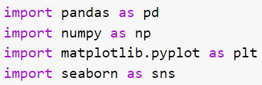
IMPORT LIBRARY
Using several library from Python to Analyze, Visualization, and Manipulation
Pandas is library using for data manipulation, create dataframe, & load dataset.
NumPy is a powerful library in Python used for numerical computations.
Matplotlib is a comprehensive library in Python used for creating static, animated, and interactive visualizations.
Seaborn is a Python data visualization library based on Matplotlib that provides a high-level interface for drawing attractive and informative statistical graphics.

Slide 8

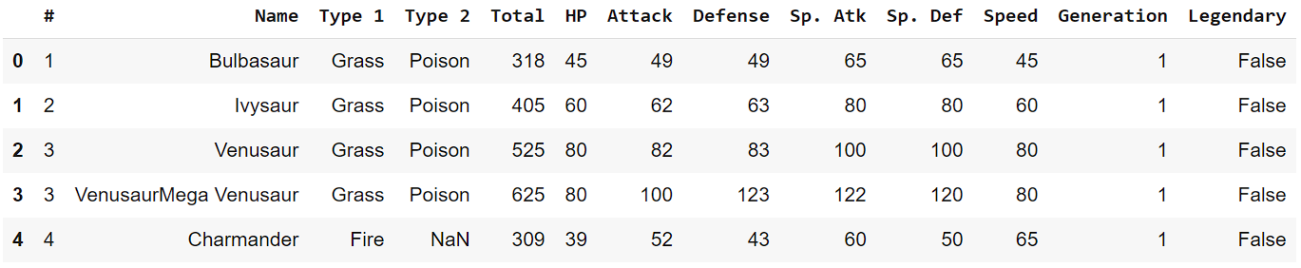
DATA PREPARATION
LOAD DATASET:
Load the Pokemon Dataset using Pandas alias (pd) and save in “df” variable, then show preview dataset with 5 rows using .head() function. In the image of dataframe above, we can see several attributes or column data contained in the Pokemon dataset. We can also see the names of existing Pokemon characters.

Slide 9

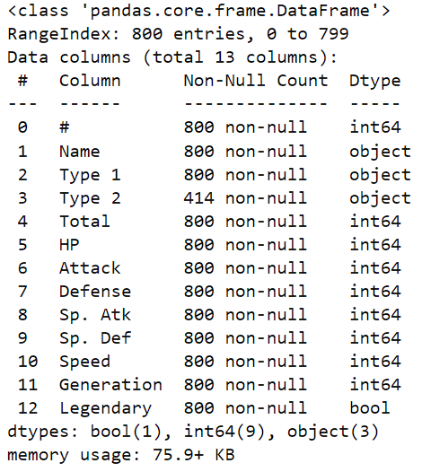
DATA PREPARATION
INFORMATION OF DATASET:
Show the information related to the pokemon dataset using the .info() function and you can see that there is some information such as the number of rows being 800 and columns being 13. Then, there is information regarding the data type of each column and the memory allocation used to store the dataset.
We can also see a different number of rows on Type 2 column.

Slide 10

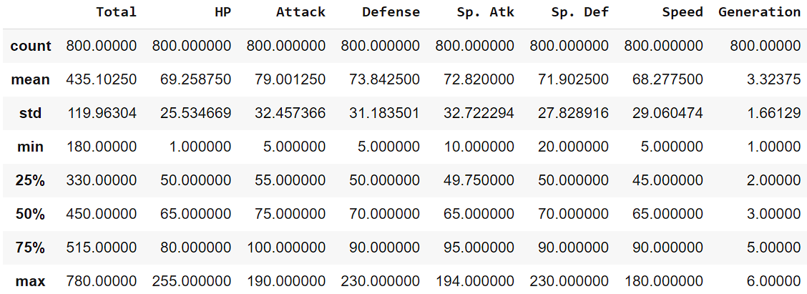
DATA PREPARATION
DATA CLEANING:
Drop the "#" column as it only serves as an ID for each Pokemon character.
And then, show a summarize of statistics value using .describe(). This give us information about statistics like a Mean, Stamdard Deviation, Min, Max, Count, And Quartile.

Slide 11

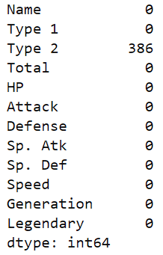
DATA PREPARATION
DATA CLEANING:
Calculate null values ​​or values ​​that do not exist in the dataset. Previously, when displaying dataset information, the number of rows was different, namely in the Type 2 column because there was a null value. Total of null values on Type 2 column is 386. We have to deal with these null values ​​in the Type 2 column.

Slide 12

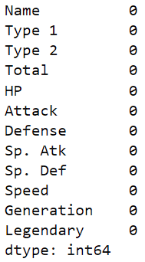
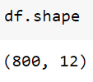


DATA PREPARATION
DATA CLEANING:
We can delete/drop rows that have null values. However, by deleting 386 rows there will be a change in the shape of the dataset or a change in the number of rows and columns in the dataset.
Before drop rows
After drop rows

Slide 13
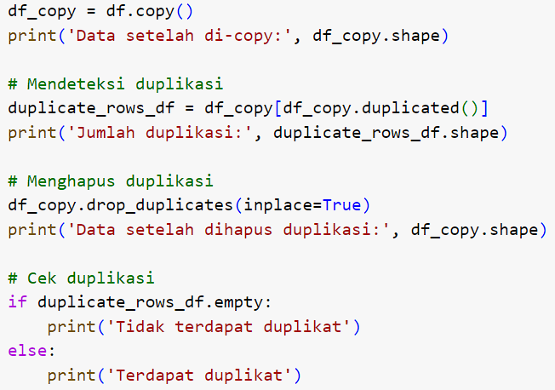
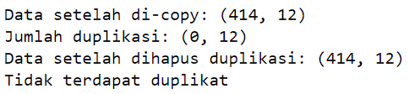
DATA PREPARATION
DATA CLEANING:
After that, check for duplication of the dataset, is there duplication in the dataset or not?
From the available information, it can be seen that there are no duplicates in the dataset.

Slide 14
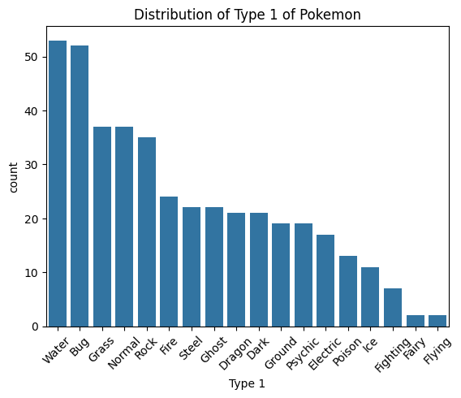
EXPLORATORY DATA ANALYSIS
DISTRIBUTION OF TYPES OF POKEMON: (TYPE 1)
Based on the chart on the side, the type of Pokemon in the Type 1 category with the largest number belongs to Water type Pokemon. However, the smallest is Fairy and Flying type Pokemon.

Slide 15
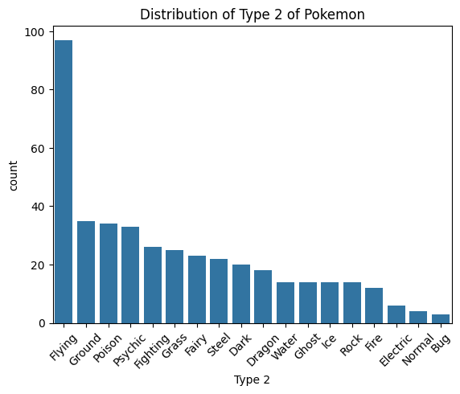
EXPLORATORY DATA ANALYSIS
DISTRIBUTION OF TYPES OF POKEMON: (TYPE 2)
Based on the chart on the side, the type of Pokemon in the Type 2 category with the largest number belongs to Flying type Pokemon. This type has a number above the average compared to other types in the Type 1 category. However, the smallest is Bug type Pokemon.

Slide 16
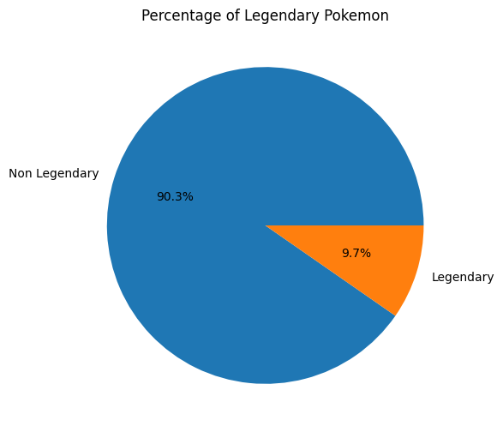
EXPLORATORY DATA ANALYSIS
PERCENTAGE OF LEGENDARY POKEMON:
Based on the pie chart on the side, the percentage of the total Pokemon type is Legendary or non-Legendary, the highest total percentage is occupied by non-Legendary type Pokemon.
This percentage is quite far from the percentage of Legendary Pokemon types.

Slide 17
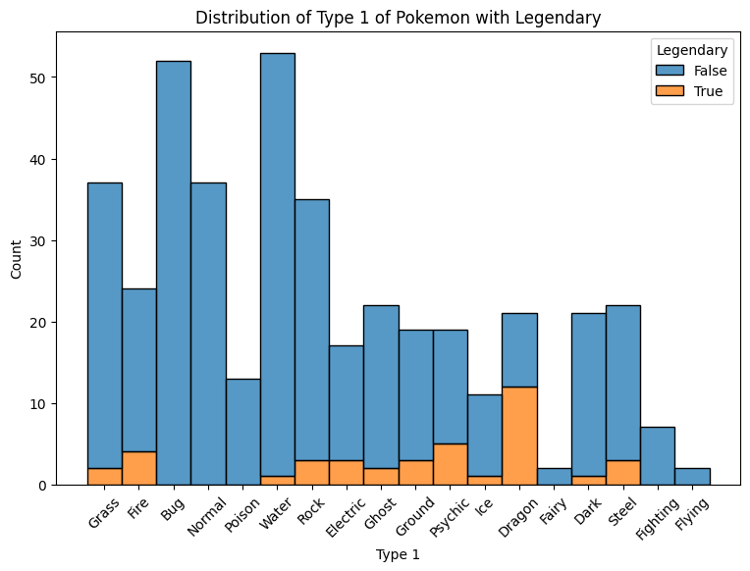
EXPLORATORY DATA ANALYSIS
DISTRIBUTION OF TYPE 1 WITH LEGENDARY:
Based on the histogram on the side, the distribution of Legendary, there are only 12 types of Pokemon in the Type 1 category with the highest number of legendary Pokemon being Dragon Type Pokemon.
The other 6 types of Pokemon in the Type 1 category are not legendary Pokemon (non-legendary).

Slide 18
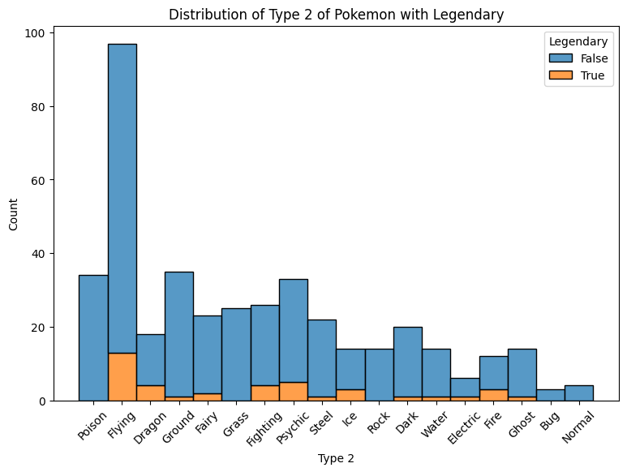
EXPLORATORY DATA ANALYSIS
DISTRIBUTION OF TYPE 2 WITH LEGENDARY:
Based on the histogram on the side, the distribution of Legendary, there are only 13 types of Pokemon in the Type 2 category with the highest number of legendary Pokemon being Flying Type Pokemon.
The other 5 types of Pokemon in the Type 2 category are not legendary Pokemon (non-legendary).

Slide 19
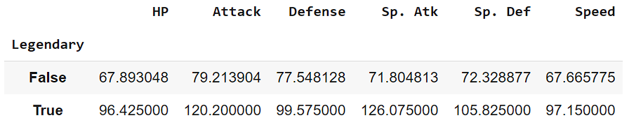
EXPLORATORY DATA ANALYSIS
AVERAGE VALUE OF POKEMON ATTRIBUTES WITH LEGENDARY:
Based on the average calculation of legendary and non-legendary type Pokemon, attribute values ​​such as HP, Attack, Defense, Sp. Atk, Sp. Def, the speed of Legendary type Pokemon is higher than non-legendary type Pokemon. Although in terms of distribution, the number of legendary Pokemon is less than the number of non-legendary Pokemon.

Slide 20
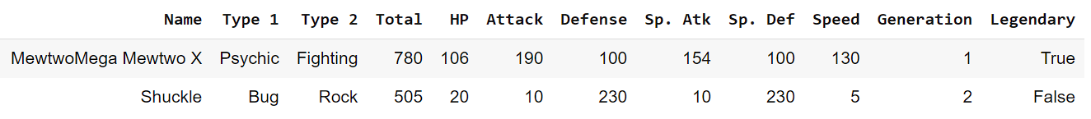
EXPLORATORY DATA ANALYSIS
COMPARISON BETWEEN HIGHEST ATTACK WITH WEAKEST ATTACK:
Based on the dataframe above, the Pokemon named MewtwoMega MewTwo X has the highest Attack with a value of 190. It is also a Legendary Pokemon. While the pokemon named Shuckle has the weakest Attack with an Attack value of only 10, with a non-legendary type of pokemon.

Slide 21
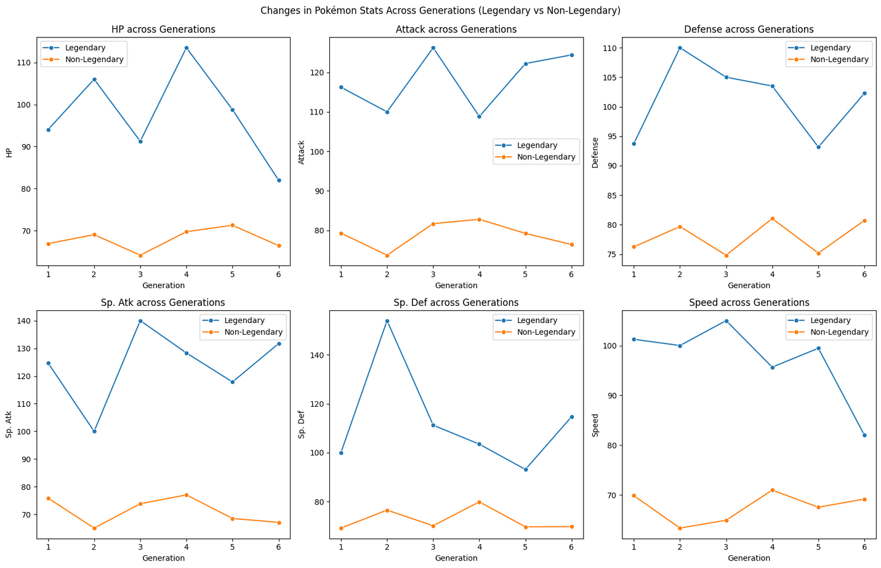
EXPLORATORY DATA ANALYSIS
CHANGES IN LEGENDARY VS NON-LEGENDARY POKEMON TYPES BASED ON GENERATIONS AND POKEMON STATS/ATTRIBUTES

Slide 22
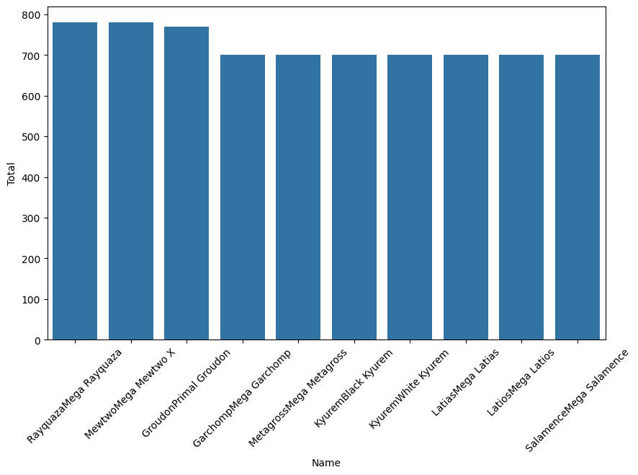
EXPLORATORY DATA ANALYSIS
TOP 10 POKEMON BY TOTAL ATTRIBUTES:
Based on the chart on the side, the distribution of the total Pokemon attributes is grouped into the top 10 Pokemon with the largest total attributes. The distance between the 10 Pokemon is not far from each other.

Slide 23
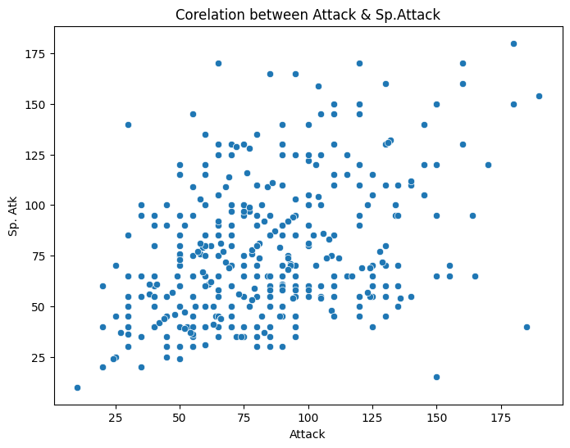
EXPLORATORY DATA ANALYSIS
TOP 10 POKEMON BY TOTAL ATTRIBUTES:
Based on the chart on the side, the correlation between the Attack attribute and Sp. Atk, the form of correlation is Weak Positive Correlation. It means, , there is a possibility of a relationship between values Sp. Atk is greater than the Attack value.

Slide 24
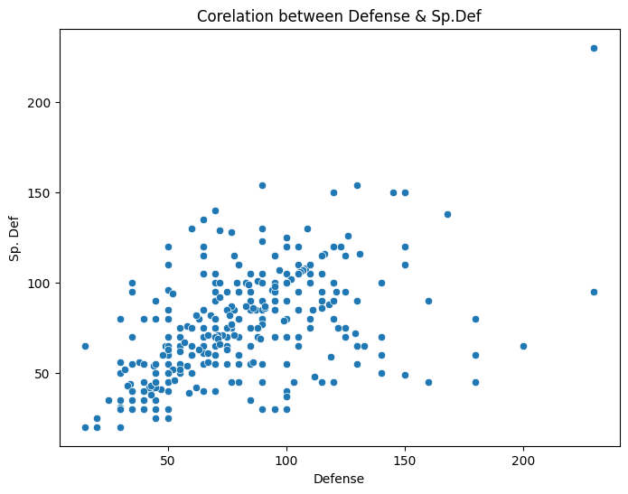
EXPLORATORY DATA ANALYSIS
TOP 10 POKEMON BY TOTAL ATTRIBUTES:
Based on the chart on the side, the correlation between the Defense attribute and Sp. Def, the form of correlation is Weak Positive Correlation. It means, , there is a possibility of a relationship between values Sp. Def is greater than the Defense value.

Slide 25
CONCLUSION
From several explanations related to EDA in the previous slides, the following conclusions can be drawn:
The legendary attribute of a Pokemon indicates that the Pokemon character has great abilities based on existing stats such as HP, Attack, Defense, Sp. Attack, Sp. Defense, and Speed. If you are pitted against a non-legendary Pokemon, even if there are a lot of them, the non-legendary Pokemon will still lose against a legendary Pokemon.
The 5th generation of Pokemon has more types of legendary Pokemon than the newest generation of Pokemon, namely the 6th generation.

Slide 26
CONCLUSION
From several explanations related to EDA in the previous slides, the following conclusions can be drawn:
There is a change and decrease in the value of attributes such as HP, Attack, Defense, Sp. Atk, Sp. Def, Speed ​​of legendary type Pokemon in each generation. The changes and decreases in the values ​​of these attributes are quite significant.
Correlation between Attack and Sp. Atk and Defense with Sp. Def has the same form of correlation, namely Weak Positive Correlation. Where there is a possibility, Pokemon's Sp. ATK will be greater than Pokemon's Attack. Therefore, the greater the Attack, the greater the Sp. Atk.

Slide 27




THAT’S IT, LET’S CONNECT WITH ME!!!
farrelpaksiaditya@gmail.com
+62 838 1543 0020
www.linkedin.com/in/farrel-paksi-aditya-4248002a5
@_frladtya03

